Slide 1
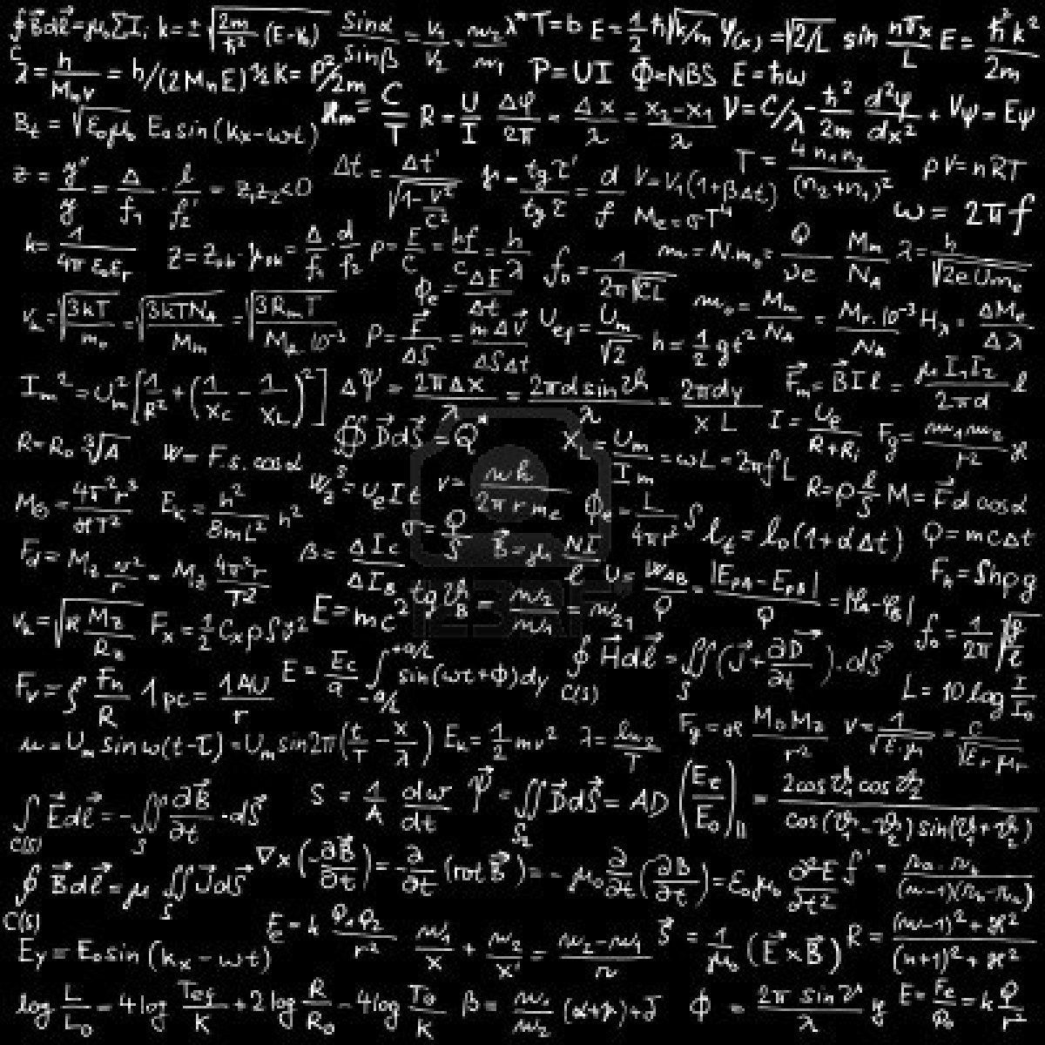
al-Farabi Kazakh National University
PARTIAL DIFFERENTIAL EQUATIONS
Professor S. Serovajsky
serovajskys@mail.ru
Almaty, 2021

Slide 2
Partial differential equations
2
Part I
INTRODUCTION

Slide 3
Content of Part I
3
What is this?
Why it is important?
How can we begin to analyze it?

Slide 4
What do we know?
4
Partial differential equation is an extension of the ordinary differential equation to the case where unknown function depends from many variables

Slide 5
Partial differential equations
Part I. INTRODUCTION
Lecture 2 Partial differential equations as mathematical models

Slide 6
Content of lecture
6
Heat equation and its interpretations

Slide 7
Content of lecture
6
Heat equation and its interpretations
String vibrating equation

Slide 8
Content of lecture
6
Heat equation and its interpretations
String vibrating equation
Equations of stationary systems

Slide 9
Heat equation
7
An inhomogeneous non-uniformly heated body is considered, which is assumed to be rather long and thin

Slide 10
Heat equation
7
An inhomogeneous non-uniformly heated body is considered, which is assumed to be rather long and thin
State function?

Slide 11
Heat equation
7
An inhomogeneous non-uniformly heated body is considered, which is assumed to be rather long and thin
State function?
To heat a body of mass m with temperature u₁ to temperature u₂, it is necessary to expend the quantity of heat
Q = cm(u₂ – u₁),

Slide 12
Heat equation
7
An inhomogeneous non-uniformly heated body is considered, which is assumed to be rather long and thin
State function?
To heat a body of mass m with temperature u₁ to temperature u₂, it is necessary to expend the quantity of heat
Q = cm(u₂ – u₁),
where the system parameter с is?

Slide 13
Heat equation
7
An inhomogeneous non-uniformly heated body is considered, which is assumed to be rather long and thin
State function?
To heat a body of mass m with temperature u₁ to temperature u₂, it is necessary to expend the quantity of heat
Q = cm(u₂ – u₁),
where the system parameter с is? heat capacity

Slide 14
Heat equation. 2
8
Q = cm(u₂ – u₁)
Mass is not a characteristic of a distributed system

Slide 15
Heat equation. 2
8
Q = cm(u₂ – u₁)
Mass is not a characteristic of a distributed system
The mass of a homogeneous body of length Δх is m=ρΔx
Q = cρ(u₂ – u₁)Δx

Slide 16
Heat equation. 2
8
Q = cm(u₂ – u₁)
Mass is not a characteristic of a distributed system.
The mass of a homogeneous body of length Δх is m=ρΔx
Q = cρ(u₂ – u₁)Δx
What is the disadvantage of this formula?

Slide 17
Heat equation. 2
8
Q = cm(u₂ – u₁)
Mass is not a characteristic of a distributed system.
The mass of a homogeneous body of length Δх is m=ρΔx
Q = cρ(u₂ – u₁)Δx
What is the disadvantage of this formula?
For an inhomogeneous body, heat quantity of a small section dx is dQ = cρ(u₂ – u₁)dx

Slide 18
Heat equation. 2
8
Q = cm(u₂ – u₁)
Mass is not a characteristic of a distributed system.
The mass of a homogeneous body of length Δх is m=ρΔx
Q = cρ(u₂ – u₁)Δx
What is the disadvantage of this formula?
For an inhomogeneous body, heat quantity of a small section dx is dQ = cρ(u₂ – u₁)dx
Let u₁ be a temperature of the body at the time t, u₂ – at the time t+Δt

Slide 19
Heat equation. 2
8
Q = cm(u₂ – u₁)
Mass is not a characteristic of a distributed system.
The mass of a homogeneous body of length Δх is m=ρΔx
Q = cρ(u₂ – u₁)Δx
What is the disadvantage of this formula?
For an inhomogeneous body, heat quantity of a small section dx is dQ = cρ(u₂ – u₁)dx
Let u₁ be a temperature of the body at the time t, u₂ – at the time t+Δt
The heat quantity required to heat a body of length dx for a time from t to t+Δt
dQ = cρ[u(x,t+Δt) – u(x,t)]dх

Slide 20
Heat equation. 2
8
Q = cm(u₂ – u₁)
Mass is not a characteristic of a distributed system.
The mass of a homogeneous body of length Δх is m=ρΔx
Q = cρ(u₂ – u₁)Δx
What is the disadvantage of this formula?
For an inhomogeneous body, heat quantity of a small section dx is dQ = cρ(u₂ – u₁)dx
Let u₁ be a temperature of the body at the time t, u₂ – at the time t+Δt
The heat quantity required to heat a body of length dx for a time from t to t+Δt
dQ = cρ[u(x,t+Δt) – u(x,t)]dх
How much heat is required to heat the interval [х,х+Δх]?

Slide 21
Heat equation. 3
9

Slide 22
Heat equation. 3
9
Question: What could be the reason for the change in the quantity of heat?

Slide 23
Heat equation. 3
9
Question: What could be the reason for the change in the quantity of heat?
Temperature redistribution is characterized by heat flux

Slide 24
Heat equation. 3
9
Question: What could be the reason for the change in the quantity of heat?
Temperature redistribution is characterized by heat flux
Heat flux q is the quantity of heat passing through a given point per unit time

Slide 25
Heat equation. 3
9
Question: What could be the reason for the change in the quantity of heat?
Temperature redistribution is characterized by heat flux
Heat flux q is the quantity of heat passing through a given point per unit time
During the time from t to t+Δt, the heat quantity Q = qΔt pass through the point

Slide 26
Heat equation. 3
9
Question: What could be the reason for the change in the quantity of heat?
Temperature redistribution is characterized by heat flux
Heat flux q is the quantity of heat passing through a given point per unit time
During the time from t to t+Δt, the heat quantity Q = qΔt pass through the point
What is the disadvantage of this formula?

Slide 27
Heat equation. 3
9
Question: What could be the reason for the change in the quantity of heat?
Temperature redistribution is characterized by heat flux
Heat flux q is the quantity of heat passing through a given point per unit time
During the time from t to t+Δt, the heat quantity Q = qΔt pass through the point
What is the disadvantage of this formula?
In the case of a variable heat flux, in an arbitrarily short time dt, the heat quantity dQ = qdt pass through the point

Slide 28
Heat equation. 3
9
Question: What could be the reason for the change in the quantity of heat?
Temperature redistribution is characterized by heat flux
Heat flux q is the quantity of heat passing through a given point per unit time
During the time from t to t+Δt, the heat quantity Q = qΔt pass through the point
What is the disadvantage of this formula?
In the case of a variable heat flux, in an arbitrarily short time dt, the heat quantity dQ = qdt pass through the point
How much heat pass through the point during the time from t to t+Δt ?

Slide 29
Heat equation. 4
10
For definiteness, we choose the direction of the coordinate to coincide with the direction of the heat flux

Slide 30
Heat equation. 4
10
For definiteness, we choose the direction of the coordinate to coincide with the direction of the heat flux
What is the change in the quantity of heat on the interval [х,х+Δх] during the time from t to t+Δt ?

Slide 31
Heat equation. 4
10
For definiteness, we choose the direction of the coordinate to coincide with the direction of the heat flux
What is the change in the quantity of heat on the interval [х,х+Δх] during the time from t to t+Δt ?

Slide 32
Heat equation. 5
11
Points х₁ and х₂ with temperatures u₁ and u₂ are given

Slide 33
Heat equation. 5
11
Points х₁ and х₂ with temperatures u₁ and u₂ are given
Teat flux from point to point is the greater, the greater the temperature difference and the smaller the distance between the points

Slide 34
Heat equation. 5
11
Points х₁ and х₂ with temperatures u₁ and u₂ are given
Teat flux from point to point is the greater, the greater the temperature difference and the smaller the distance between the points

Slide 35
Heat equation. 5
11
Points х₁ and х₂ with temperatures u₁ and u₂ are given
Teat flux from point to point is the greater, the greater the temperature difference and the smaller the distance between the points
Heat moves from a hot body to a cold one
where λ - coefficient of thermal conductivity.

Slide 36
Heat equation. 5
11
Points х₁ and х₂ with temperatures u₁ and u₂ are given
Teat flux from point to point is the greater, the greater the temperature difference and the smaller the distance between the points
Heat moves from a hot body to a cold one
where λ - coefficient of thermal conductivity. Fourier law

Slide 37
Heat equation. 5
11
Points х₁ and х₂ with temperatures u₁ and u₂ are given
Teat flux from point to point is the greater, the greater the temperature difference and the smaller the distance between the points
Heat spreads from a hot body to a cold one
where λ - coefficient of thermal conductivity. Fourier law

Slide 38
Heat equation. 6
12

Slide 39
Heat equation. 6
12
Conservation law: Q₁ = Q₂

Slide 40
Heat equation. 6
12
Conservation law: Q₁ = Q₂

Slide 41
Heat equation. 6
12
Conservation law: Q₁ = Q₂
Main theorem

Slide 42
Heat equation. 7
13
where ξ∈[x, x+Δx], τ∈[t, t+Δt]

Slide 43
Heat equation. 7
13
where ξ∈[x, x+Δx], τ∈[t, t+Δt]. Heat equation

Slide 44
Heat equation. 7
13
where ξ∈[x, x+Δx], τ∈[t, t+Δt]. Heat equation
For the homogeneous body
u_{t} = a²u_{xx}
where - thermal diffusivity

Slide 45
Heat equation. 8
14
Extensions
Heat transfer under the heat source
u_{t} = a²u_{xx} + f

Slide 46
Heat equation. 8
14
Extensions
Heat transfer under the heat source
u_{t} = a²u_{xx} + f
Two-dimensional case
u_{t} = a² (u_{xx} + u_{yy})

Slide 47
Heat equation. 8
14
Extensions
Heat transfer under the heat source
u_{t} = a²u_{xx} + f
Two-dimensional case
u_{t} = a² (u_{xx} + u_{yy})
Three-dimensional case
u_{t} = a² (u_{xx} + u_{yy} + u_{zz})

Slide 48
Heat equation. 8
14
Extensions
Heat transfer under the heat source
u_{t} = a²u_{xx} + f
Two-dimensional case
u_{t} = a² (u_{xx} + u_{yy})
Three-dimensional case
u_{t} = a² (u_{xx} + u_{yy} + u_{zz})
Determine the Laplace operator Δ as the sum of second partial derivatives
u_{t} = a²Δu

Slide 49
Heat Molecular Dictionary
15
physics direction | thermal physics | molecular physics
phenomenon | thermal conductivity | diffusion
local characteristic | temperature | concentration
global characteristic | heat quantity | substance quantity
flux | heat flux | diffusion flux
law | Fourier law | Fick’s law
transfer coefficient | thermal conductivity | diffusion coefficient
state equation | heat equation | diffusion equation

Slide 50
Physics Economics Dictionary
16
process | heat transfer | diffusion | goods transfer
measure | heat quantity | mass | goods quantity
state function | temperature | concentration | goods density
measure flux | heat flux | diffusion flux | goods flux
equilibrium law | Fourier | Fick
equilibrium coefficient | thermal conductivity | diffusion coefficient | goods transfer coefficient
law of measure conservation | law of heat conservation | law of mass conservation | law of goods conservation
transfer equation | heat equation | diffusion equation | goods transfer equation

Slide 51
Vibration of string
17
Transverse vibrations of a sufficiently long thin flexible string are considered

Slide 52
Vibration of string
17
Transverse vibrations of a sufficiently long thin flexible string are considered
State function?

Slide 53
Vibration of string
17
Transverse vibrations of a sufficiently long thin flexible string are considered
State function?
Momentum of a body of mass m moving with a velocity v is ???

Slide 54
Vibration of string
17
Transverse vibrations of a sufficiently long thin flexible string are considered
State function?
Momentum of a body of mass m moving with a velocity v is p=mv

Slide 55
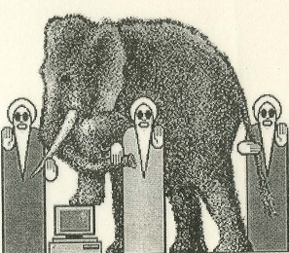
Vibration of string
17
Transverse vibrations of a sufficiently long thin flexible string are considered
State function?
Momentum of a body of mass m moving with a velocity v is p=mv
Mass of a homogeneous string of length Δx is determined by the formula m=ρΔx

Slide 56
Vibration of string
17
Transverse vibrations of a sufficiently long thin flexible string are considered
State function?
Momentum of a body of mass m moving with a velocity v is p=mv
Mass of a homogeneous string of length Δx is determined by the formula m=ρΔx
Momentum of a body of length Δx moving at a velocity u_{t} is equal to p = ρu_{t}Δx

Slide 57
Vibration of string
17
Transverse vibrations of a sufficiently long thin flexible string are considered
State function?
Momentum of a body of mass m moving with a velocity v is ???
Mass of a homogeneous string of length Δx is determined by the formula m=ρΔx
Momentum of a body of length Δx moving at a velocity u_{t} is equal to p = ρu_{t}Δx
What is the disadvantage of this formula?

Slide 58
Vibration of string
17
Transverse vibrations of a sufficiently long thin flexible string are considered
State function?
Momentum of a body of mass m moving with a velocity v is p=mv
Mass of a homogeneous string of length Δx is determined by the formula m=ρΔx
Momentum of a body of length Δx moving at a velocity u_{t} is equal to p = ρu_{t}Δx
What is the disadvantage of this formula? How should the last formula be adjusted?

Slide 59
Vibration of string. 2
18
Momentum of the string interval [х,x+Δx] is

Slide 60
Vibration of string. 2
18
Momentum of the string interval [х,x+Δx] is
Change in the momentum of the interval for the time from t to t+Δt

Slide 61
Vibration of string. 2
18
Momentum of the string interval [х,x+Δx] is
Change in the momentum of the interval for the time from t to t+Δt
Why does the momentum change?

Slide 62
Vibration of string. 2
18
Momentum of the string interval [х,x+Δx] is
Change in the momentum of the interval for the time from t to t+Δt
Why does the momentum change?
If a constant force F acts on the body, then in time Δt it imparts a momentum ???

Slide 63
Vibration of string. 2
18
Momentum of the string interval [х,x+Δx] is
Change in the momentum of the interval for the time from t to t+Δt
Why does the momentum change?
If a constant force F acts on the body, then in time Δt it imparts a momentum p = FΔt

Slide 64
Vibration of string. 2
18
Momentum of the string interval [х,x+Δx] is
Change in the momentum of the interval for the time from t to t+Δt
Why does the momentum change?
If a constant force F acts on the body, then in time Δt it imparts an momentum p = FΔt
What is the disadvantage of this formula?

Slide 65
Vibration of string. 2
18
Momentum of the string interval [х,x+Δx] is
Change in the momentum of the interval for the time from t to t+Δt
Why does the momentum change?
If a constant force F acts on the body, then in time Δt it imparts an momentum ??? p = FΔt
What is the disadvantage of this formula? How should the last formula be changed?

Slide 66
Vibration of string. 2
18
Momentum of the string interval [х,x+Δx] is
Change in the momentum of the interval for the time from t to t+Δt
Why does the momentum change?
If a constant force F acts on the body, then in time Δt it imparts an impulse ??? p = FΔt
What is the disadvantage of this formula? How should the last formula be changed? What is the momentum for the time from t to t+Δt?

Slide 67
Vibration of string. 3
19
For the time from t to t +Δt we get

Slide 68
Vibration of string. 3
19
For the time from t to t +Δt we get

Slide 69
Vibration of string. 3
19
For the time from t to t +Δt we get
Force F is the tension projection k : F = ksinα

Slide 70
Vibration of string. 3
19
For the time from t to t +Δt we get
Force F is the tension projection k : F = ksinα
For small oscillation F = ktgα

Slide 71
Vibration of string. 3
19
For the time from t to t +Δt we get
Force F is the tension projection k : F = ksinα
For small oscillation F = ktgα
What means of using tangent?

Slide 72
Vibration of string. 4
20
Tension of a string interval is determined by the difference in forces acting at its ends

Slide 73
Vibration of string. 4
20
Tension of a string interval is determined by the difference in forces acting at its ends

Slide 74
Vibration of string. 4
21
Tension of a string interval is determined by the difference in forces acting at its ends

Slide 75
Vibration of string. 5
22
Next?

Slide 76
Vibration of string. 5
22
Next?
Momentum conservation law

Slide 77
Vibration of string. 5
22
Next?
Momentum conservation law
Next?

Slide 78
Vibration of string. 5
22
Next?
Momentum conservation law
Next?

Slide 79
Vibration of string. 5
22
Next?
Momentum conservation law
Next?

Slide 80
Vibration of string. 5
22
Next?
Momentum conservation law
Next?
Next?

Slide 81
Vibration of string. 5
22
Next?
Momentum conservation law
Next?
Next?
String vibration equation

Slide 82
Vibration of string. 6
23
String vibration equation for homogeneous case
u_{tt} = a² u_{xx}

Slide 83
Vibration of string. 6
23
String vibration equation for homogeneous case
u_{tt} = a² u_{xx}
Extensions
Vibrating under the exterior force
u_{tt} = a² u_{xx} + f

Slide 84
Vibration of string. 6
23
String vibration equation for homogeneous case
u_{tt} = a² u_{xx}
Extensions
Vibrating under the exterior force
u_{tt} = a² u_{xx} + f
Two-dimensional case (membrane vibrating equation)
u_{tt} = a² (u_{xx} + u_{yy})

Slide 85
Vibration of string. 6
23
String vibration equation for homogeneous case
u_{tt} = a² u_{xx}
Extensions
Vibrating under the exterior force
u_{tt} = a² u_{xx} + f
Two-dimensional case (membrane vibrating equation)
u_{tt} = a² (u_{xx} + u_{yy})
Three-dimensional case (wave equation)
u_{tt} = a² (u_{xx} + u_{yy} + u_{zz})

Slide 86
Vibration of string. 6
23
String vibration equation for homogeneous case
u_{tt} = a² u_{xx}
Extensions
Vibrating under the exterior force
u_{tt} = a² u_{xx} + f
Two-dimensional case (membrane vibrating equation)
u_{tt} = a² (u_{xx} + u_{yy})
Three-dimensional case (wave equation)
u_{tt} = a² (u_{xx} + u_{yy} + u_{zz})
u_{tt} = a² Δu

Slide 87
Stationary heat transfer
24
We determined before the heat equation
u_{t} = a²Δu

Slide 88
Stationary heat transfer
24
We determined before the heat equation
u_{t} = a²Δu
What happens if the temperature does not change over time?

Slide 89
Stationary heat transfer
24
We determined before the heat equation
u_{t} = a²Δu
What happens if the temperature does not change over time?
Δu = 0

Slide 90
Stationary heat transfer
24
We determined before the heat equation
u_{t} = a²Δu
What happens if the temperature does not change over time?
Δu = 0
This equality is called the Laplace equation

Slide 91
Stationary heat transfer
24
We determined before the heat equation
u_{t} = a²Δu
What happens if the temperature does not change over time?
Δu = 0
This equality is called the Laplace equation
If have a heat source, that is does not depend from the time, then we have the following non-homogeneous equation
Δu = f

Slide 92
Stationary heat transfer
24
We determined before the heat equation
u_{t} = a²Δu
What happens if the temperature does not change over time?
Δu = 0
This equality is called the Laplace equation
If have a heat source, that is does not depend from the time, then we have the following non-homogeneous equation
Δu = f
This is called the Poisson equation

Slide 93
Electrostatic field
25
The mathematical model of electrodynamics is based on ??? equations

Slide 94
Electrostatic field
25
The mathematical model of electrodynamics is based on Maxwell's equations

Slide 95
Electrostatic field
25
The mathematical model of electrodynamics is based on Maxwell's equations
In the stationary case, the electric field is characterized by the equation
divE = 4πε ⁻¹ρ,
where Е – vector of electric field strength
ρ – charge density ε – dielectric constant
div – ???

Slide 96
Electrostatic field
25
The mathematical model of electrodynamics is based on Maxwell's equations
Electric field is characterized by the equation
divE = 4πε ⁻¹ρ,
where Е – vector of electric field strength
ρ – charge density ε – dielectric constant
div – divergence (sum of first derivatives of vector function)

Slide 97
Electrostatic field. 2
26
divE = 4πε ⁻¹ρ,

Slide 98
Electrostatic field. 2
26
divE = 4πε ⁻¹ρ,
To describe the field, a scalar state function is introduced, called the potential of the electrostatic field u related to the strength by the relation
E = –∇u
where ∇ – what?

Slide 99
Electrostatic field. 2
26
divE = 4πε ⁻¹ρ,
To describe the field, a scalar state function is introduced, called the potential of the electrostatic field u related to the strength by the relation
E = –∇u
where ∇ – gradient (vector of partial derivatives)

Slide 100
Electrostatic field. 2
26
divE = 4πε ⁻¹ρ,
To describe the field, a scalar state function is introduced, called the potential of the electrostatic field u related to the strength by the relation
E = –∇u
where ∇ – gradient (vector of partial derivatives)
div∇u = –4πε ⁻¹ρ

Slide 101
Electrostatic field. 2
26
divE = 4πε ⁻¹ρ,
To describe the field, a scalar state function is introduced, called the potential of the electrostatic field u related to the strength by the relation
E = –∇u
where ∇ – gradient (vector of partial derivatives)
div∇u = –4πε ⁻¹ρ
What is div∇?

Slide 102
Electrostatic field. 2
26
divE = 4πε ⁻¹ρ,
To describe the field, a scalar state function is introduced, called the potential of the electrostatic field u related to the strength by the relation
E = –∇u
where ∇ – gradient (vector of partial derivatives)
div∇u = –4πε ⁻¹ρ
What is div∇?
Δu = –4πε ⁻¹ρ

Slide 103
Electrostatic field. 2
26
divE = 4πε ⁻¹ρ,
To describe the field, a scalar state function is introduced, called the potential of the electrostatic field u related to the strength by the relation
E = –∇u
where ∇ – gradient (vector of partial derivatives)
div∇u = –4πε ⁻¹ρ
What is div∇?
Δu = –4πε ⁻¹ρ
Result?

Slide 104
Electrostatic field. 2
26
divE = 4πε ⁻¹ρ,
To describe the field, a scalar state function is introduced, called the potential of the electrostatic field u related to the strength by the relation
E = –∇u
where ∇ – gradient (vector of partial derivatives)
div∇u = –4πε ⁻¹ρ
What is div∇?
Δu = –4πε ⁻¹ρ
Result?
If the charge are absent, then this is transformed to …

Slide 105
Electrostatic field. 2
26
divE = 4πε ⁻¹ρ,
To describe the field, a scalar state function is introduced, called the potential of the electrostatic field u related to the strength by the relation
E = –∇u
where ∇ – gradient (vector of partial derivatives)
div∇u = –4πε ⁻¹ρ
What is div∇?
Δu = –4πε ⁻¹ρ
Result?
If the charge are absent, then this is transformed to …
Δu = 0

Slide 106
Gravitational field
27
From the law of universal gravitation,
it follows the equality
diva = 4πGρ
where a is acceleration vector, G is the gravitational constant, ρ is the density of the considered body

Slide 107
Gravitational field. 2
28
How we determine the potential energy of the body?
U = mgx = –Fx
where x is the vertical coordinate of the body,
g is the gravitational acceleration,
F is the weight of the body

Slide 108
Gravitational field. 2
28
The potential energy is
U = mgx = –Fx
where x is the vertical coordinate of the body,
g is the gravitational acceleration,
F is the weight of the body

Slide 109
Gravitational field. 2
28
The potential energy is
U = mgx = –Fx
where x is the vertical coordinate of the body,
g is the gravitational acceleration,
F is the weight of the body
For the multidimension case F=–∇U

Slide 110
Gravitational field. 2
28
The potential energy is
U = mgx = –Fx
where x is the vertical coordinate of the body,
g is the gravitational acceleration,
F is the weight of the body
For the multidimension case F=–∇U
The potential energy of a body depends on its mass The absolute characteristic of the gravitational field is the potential

Slide 111
Gravitational field. 2
28
The potential energy is
U = mgx = –Fx
where x is the vertical coordinate of the body,
g is the gravitational acceleration,
F is the weight of the body
For the multidimension case F=–∇U
The potential energy of a body depends on its mass The absolute characteristic of the gravitational field is the potential
The potential of the gravitational field is related to the potential energy of a body with mass m by the equality U = mu

Slide 112
Gravitational field. 2
28
The potential energy is
U = mgx = –Fx
where x is the vertical coordinate of the body,
g is the gravitational acceleration,
F is the weight of the body
For the multidimension case F=–∇U
The potential energy of a body depends on its mass The absolute characteristic of the gravitational field is the potential
The potential of the gravitational field is related to the potential energy of a body with mass m by the equality U = mu
F=–m∇u

Slide 113
Gravitational field. 3
29
F=–m∇u

Slide 114
Gravitational field. 3
29
F=–m∇u
By the second Newton’s law F=ma

Slide 115
Gravitational field. 3
29
F=–m∇u
By the second Newton’s law F=ma
a=–∇u

Slide 116
Gravitational field. 3
29
F=–m∇u
By the second Newton’s law F=ma
a=–∇u
We had before
diva = 4πGρ

Slide 117
Gravitational field. 3
29
F=–m∇u
By the second Newton’s law F=ma
a=–∇u
We had before
diva = 4πGρ
div∇u = –4πGρ

Slide 118
Gravitational field. 3
29
F=–m∇u
By the second Newton’s law F=ma
a=–∇u
We had before
diva = 4πGρ
div∇u = –4πGρ
Result?

Slide 119
Gravitational field. 3
29
F=–m∇u
By the second Newton’s law F=ma
a=–∇u
We had before
diva = 4πGρ
div∇u = –4πGρ
Result?
Δu = 4πGρ
The potential of the gravitational field satisfies the Poisson equation

Slide 120
Gravitational field. 3
29
F=–m∇u
By the second Newton’s law F=ma
a=–∇u
We had before
diva = 4πGρ
div∇u = –4πGρ
Result?
Δu = 4πGρ
The potential of the gravitational field satisfies the Poisson equation
The gravitational field in vacuum is characterized by the Laplace equation Δu = 0

Slide 121
Conclusions
30
Partial differential equations are mathematical models of physical (and not only physical) phenomena

Slide 122
Conclusions
30
Partial differential equations are mathematical models of physical (and not only physical) phenomena
The heat equation, string vibrating (wave) equation, and Laplace (Poisson) equation are the most important partial differential equations

Slide 123
Conclusions
30
Partial differential equations are mathematical models of physical (and not only physical) phenomena
The heat equation, string vibrating (wave) equation, and Laplace (Poisson) equation are the most important partial differential equations
These equations are the general subject of this course

Slide 124
Conclusions
30
Partial differential equations are mathematical models of physical (and not only physical) phenomena
The heat equation, string vibrating (wave) equation, and Laplace (Poisson) equation are the most important partial differential equations
These equations are the general subject of this course
Partial differential equations can have different physical interpretations

Slide 125
Conclusions
30
The heat equation is the mathematical model of the different transfer phenomena: heat transfer, mass transfer (diffusion), charge transfer (electroconductivity), goods transfer, migration, etc.

Slide 126
Conclusions
30
The heat equation is the mathematical model of the different transfer phenomena: heat transfer, mass transfer (diffusion), charge transfer (electroconductivity), goods transfer, migration, etc.
The wave equation is the mathematical model of the different oscillation phenomena: string vibration, electrical vibration in wire, acoustic (sound) wave, etc.

Slide 127
Conclusions
30
The heat equation is the mathematical model of the different transfer phenomena: heat transfer, mass transfer (diffusion), charge transfer (electroconductivity), goods transfer, migration, etc.
The wave equation is the mathematical model of the different oscillation phenomena: string vibration, electrical vibration in wire, acoustic (sound) wave, etc.
The Laplace and Poisson equations are the mathematical models of the different stationary phenomena: stationary heat (mass) transfer, electrostatic field, gravitational field, etc.

Slide 128
Task 2
31
First order partial differential equations
Required:
Using the characteristic methods, find the solution of the problem.
Make sure that the result satisfies the given equation and boundary conditions.
Explain, where we can have the boundary conditions and where we cannot have it for your concrete equation. And why?

Slide 129
What will be next?
32
CLASSIFICATION OF PARTIAL DIFFERENTIAL EQUATIONS AND ITS CANONIC TYPE

